Slide 1


Basic practice in ML Lecture 4 by Anna Levant

Slide 2
Which data problems to avoid?
Sample data correctly
Irrelevant feature selection
Data leakage
Missing data
Inaccurate scaling and normalization
Neglecting outliers
Ignoring in-balance data

Slide 3
Sample data correctly
Problem:
When choosing the data sample, it can be easy to introduce bias by selecting a dataset that misrepresents or underrepresents the real cases, which will distort the results. For example, an interview that selects only people who walk by a certain location is going to have an overrepresentation of healthy individuals.
Solution:
To avoid sampling bias, you must ensure they truly select their data at random and do not just use a particular slice simply because it’s the easiest to access. Clear definitions of the ideal dataset and the logic of the model are essential to guide effective data selection. By working with business owners and having several reviewers validate selection criteria at this early stage, machine learning teams can ensure their data sampling approach is solid.

Slide 4
Irrelevant feature selection
Problem:
in the effort to gather enough learning data, it can be challenging to ensure you include the right and relevant features.
Solution:
The process of building a well-performing model requires careful exploration and analysis to ensure you select and engineer the appropriate features. Understanding the domain and involving experts are the two most important drivers for selecting the right features. In addition, techniques such as principal component analysis (PCA), and autoencoder (DL) help focus the training effort on a smaller number of more effective features.

Slide 5
Data leakage
Problem:
Machine learning teams may accidentally gather data for training using criteria that are part of the outcome the team is trying to predict. As a result, models will show performance that is too good to be true. For example, a team might mistakenly include a variable that indicates treatment for certain illness in a model designed to predict the illness.
Solution:
The training team must thoughtfully construct their datasets using only data that in practice will be available at the time of the training, before the model estimates results.

Slide 6
Missing data
Problem:
In some cases, datasets will be incomplete due to some records missing values. For or example, missing data may not always be random, such as when survey respondents are less likely to answer a particular question. As a result, putting mean value may mislead the model.
Solution:
If you cannot ensure use of complete datasets, you can apply statistical techniques, including discarding records with missing values or using proper strategy to estimate values for the missing data.

Slide 7
Inaccurate scaling and normalization
Problem:
Your data can have different types of inputs that can have different scales of measurement. When you fail to adjust the value of the variables to allow for a common scale prior to training a model, algorithms such as linear regression, support vector machine (SVN), or k nearest neighbors (KNN) can suffer greatly. The problems occur because large ranges will induce high variance to features which, therefore, may become unnecessarily important. For example, salary data may get more weight than age if you use both as unprocessed inputs.
Solution:
You must be careful to normalize the dataset prior to beginning model training. You can transform the dataset through common statistical techniques such as standardization or feature scaling, depending on the type of data and your team’s preferred algorithm

Slide 8
Neglecting outliers
Problem:
Forgetting about outliers can have a major impact on a model’s performance. For example, they can influence linear regression model. Furthermore, different use cases require different outlier handling. For example, in the case of fraud detection, a focus on outliers in deposits should be a requirement, but in sensory temperature inputs, data outliers might be ignored.
Solution:
You should either use a modeling algorithm that handles outliers properly or filter the outliers out before training. A good starting point is to do an initial check to identify whether there are outliers in the data. The simplest approaches would be reviewing plots of the data or examining any values that are several deviations or more away from the mean.

Slide 9
Ignoring in-balanced data
Problem:
Most modeling algorithms perform best when the training data has a balanced representation of various instances. When there is a significant imbalance in data, the right metrics for measuring model performance become critical.
Solution:
Consider to generate a more balanced training set or use a cost-based learning algorithm or choose metric less sensitive: choosing the most appropriate metric will guide the training algorithm to minimize error.

Slide 10
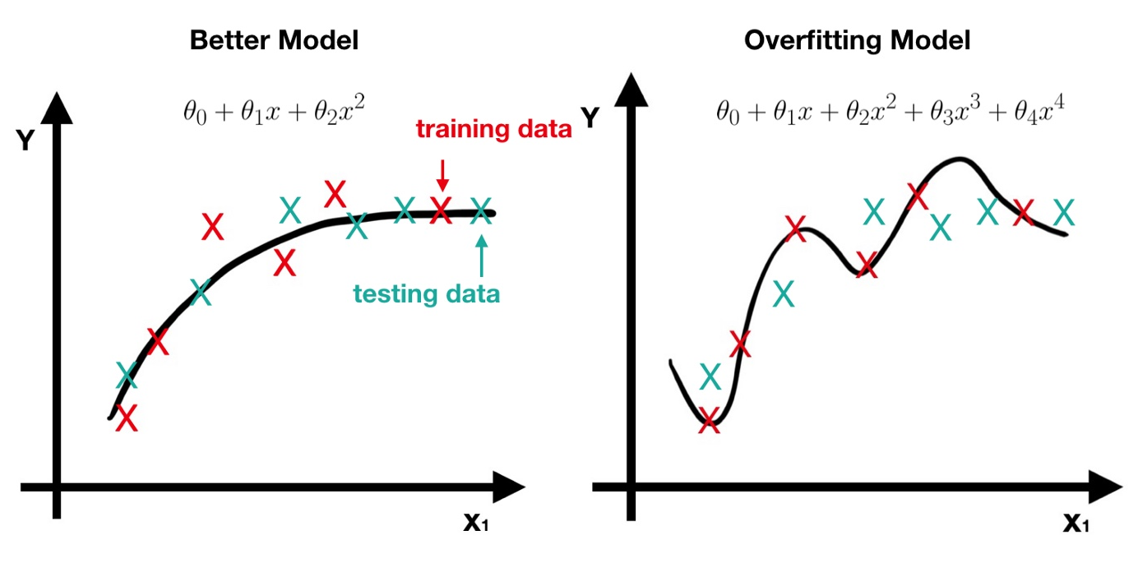
How to avoid overfitting of the model?
Use the set we didn’t see before to validate the model

Slide 11
Fundamental assumption of learning
Assumption: The distribution of training examples is identical to the distribution of test examples (including future unseen examples).
In practice, this assumption is often violated to certain degree.
Strong violations will clearly result in poor classification accuracy.
To achieve good accuracy on the test data, training examples must be sufficiently representative of the test data.

Slide 12
Evaluation methods: Holdout set
Holdout set: The available data set D is divided into two disjoint subsets,
the training set D_{train} (for learning a model)
the test set D_{test} (for testing the model)
Important: training set should not be used in testing and the test set should not be used in learning.
Unseen test set provides a unbiased estimate of real model performance
The test set is also called the holdout set. (the examples in the original data set D are all labeled )
This method is mainly used when the data set D is large.

Slide 13
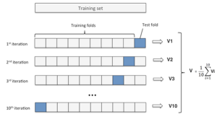
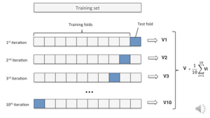
Evaluation methods: n-fold cross-validation
n-fold cross-validation: The available data is partitioned into n equal-size disjoint subsets.
Use each subset as the test set and combine the rest n-1 subsets as the training set to learn a classifier.
The procedure is run n times, which give n accuracies.
The final estimated accuracy of learning is the average of the n accuracies.
10-fold and 5-fold cross-validations are commonly used.
This method is used when the available data is not large.

Slide 14
Evaluation methods: leave one out
Leave-one-out cross-validation: This method is used when the data set is very small.
It is a special case of cross-validation
Each fold of the cross validation has only a single test example and all the rest of the data is used in training.
If the original data has m examples, this is m-fold cross-validation

Slide 16
Evaluation methods: validation
Validation set: the available data is divided into three subsets,
a training set,
a validation set and
a test set.
A validation set is used frequently for estimating parameters in learning algorithms.
In such cases, the values that give the best performance on the validation set are used as the final parameter values.
Cross-validation can be used for parameter estimating as well.

Slide 17
Supervised vs. unsupervised Learning
Supervised learning: classification is seen as supervised learning from examples.
Supervision: The data (observations, measurements, etc.) are labeled with pre-defined classes. It is like that a “teacher” gives the classes (supervision).
Test data are classified into these classes too.
Unsupervised learning (clustering)
Class labels of the data are unknown
Given a set of data, the task is to establish the existence of classes or clusters in the data

Slide 18
Regression measures
Remember that for estimation of Regression model we have used:
MSE
R²
P-value
So to get the results which could generalize the best we would take model parameters that give best measures on validation set

Slide 19
A classification example application
An emergency room in a hospital measures 17 variables (e.g., blood pressure, age, etc) of newly admitted patients.
A decision is needed: whether to put a new patient in an intensive-care unit.
Due to the high cost of ICU, those patients who may survive less than a month are given higher priority.
Problem: to predict high-risk patients and discriminate them from low-risk patients.

Slide 20
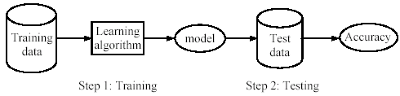
Supervised learning process: two steps
Learning (training): Learn a model using the training data
Testing: Test the model using unseen test data to assess the model accuracy

Slide 21
Classification measures
Accuracy is only one measure (error = 1-accuracy).
Accuracy is not suitable in some applications.
In text mining, we may only be interested in the documents of a particular topic, which are only a small portion of a big document collection.
In classification involving skewed or highly imbalanced data, e.g., network intrusion and financial fraud detections, we are interested only in the minority class.
High accuracy does not mean any intrusion is detected.
E.g., 1% intrusion. Achieve 99% accuracy by doing nothing.
The class of interest is commonly called the positive class, and the rest negative classes.

Slide 22
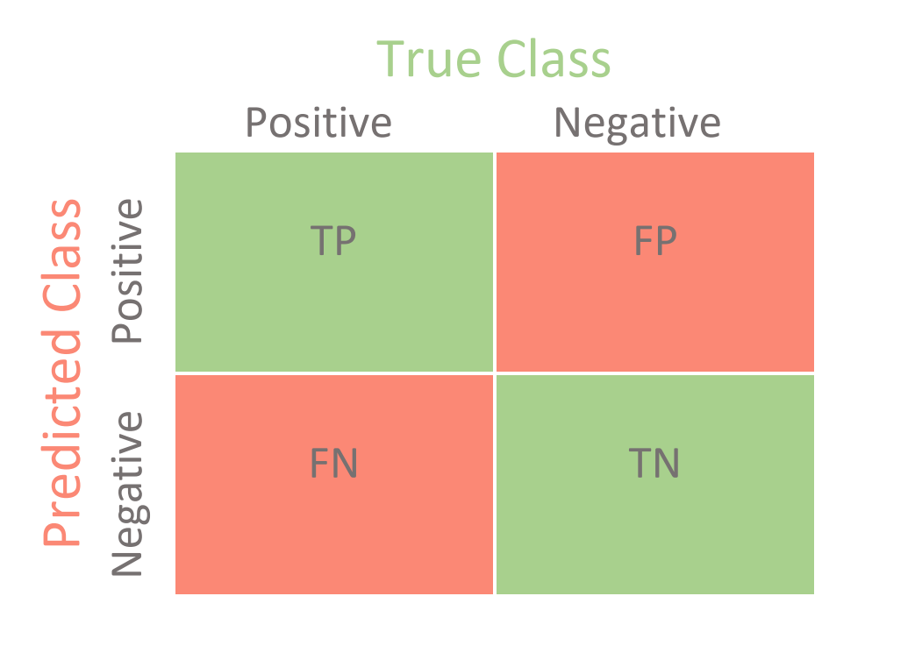
Confusion matrix
True Positive (TP): It refers to the number of predictions where the classifier correctly predicts the positive class as positive.
True Negative (TN): It refers to the number of predictions where the classifier correctly predicts the negative class as negative.
False Positive (FP): It refers to the number of predictions where the classifier incorrectly predicts the negative class as positive.
False Negative (FN): It refers to the number of predictions where the classifier incorrectly predicts the positive class as negative.

Slide 23
Precision and recall measures
Precision p is the number of correctly classified positive examples divided by the total number of examples that are classified as positive.
Recall r is the number of correctly classified positive examples divided by the total number of actual positive examples in the test set.

Slide 24
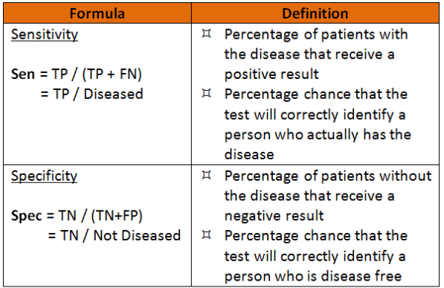
Sensitivity and specificity

Slide 25
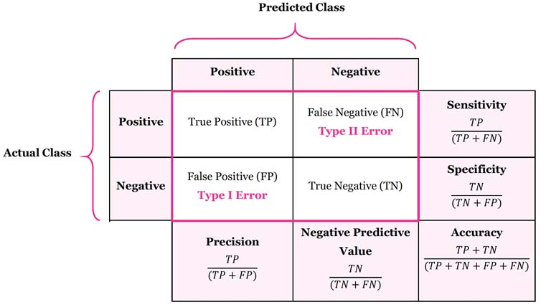
Remember

Slide 26

Example we discussed at class
Suppose we have tested 10000 people for COVID-19 and we have got the following results:
Estimated:
Accuracy of the test
Precision
Sensitivity
Specificity
 | Have COVID-19 | Don’t have COVID-19
Tested positively | 99 | 99
Tested negatively | 1 | 9801

Slide 27
We have learned today:
Supervised learning: 2 steps
Data should be divided in the cleaver way to training/validation/test set
There are several measurements of classification success:
Accuracy
Precision
Sensitivity
Specificity

Slide 28
Thank you!

Slide 29
